Slide 1

?

Slide 2
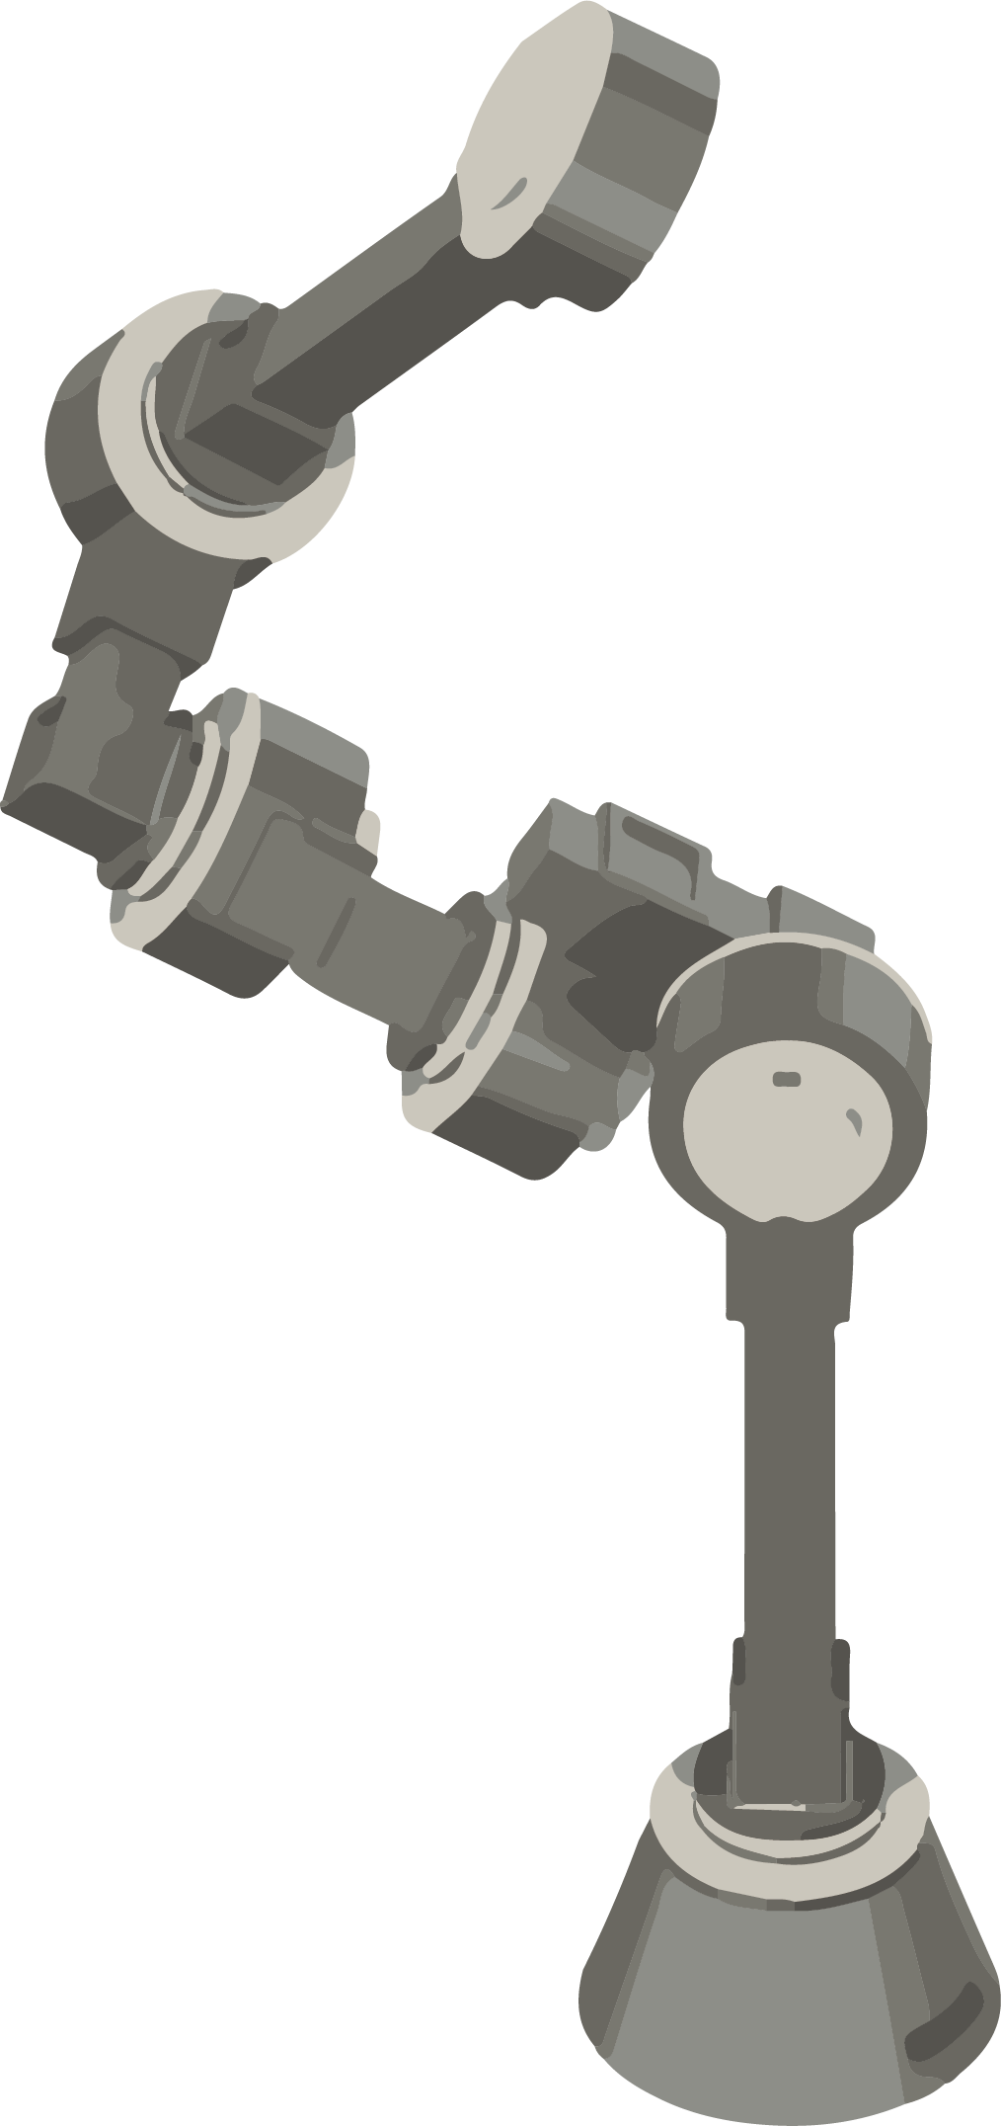
✔

Slide 3
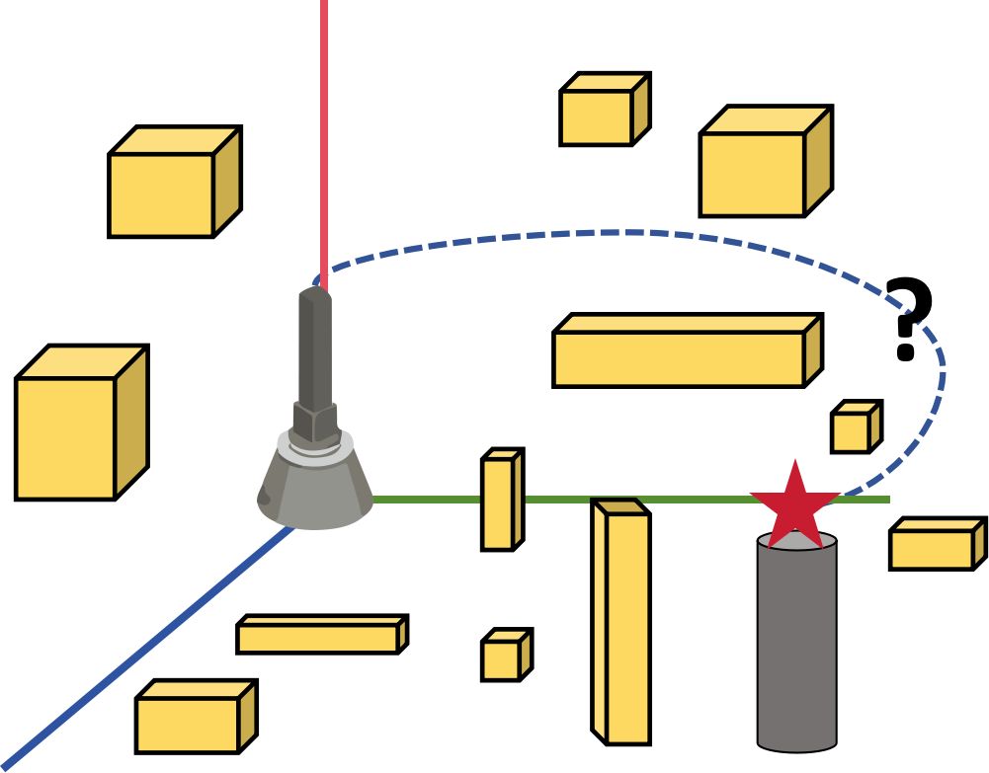
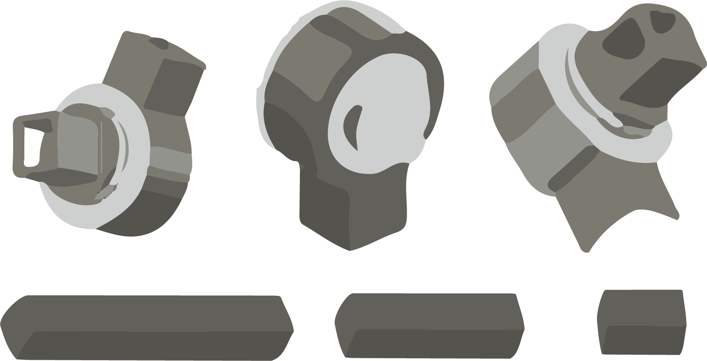



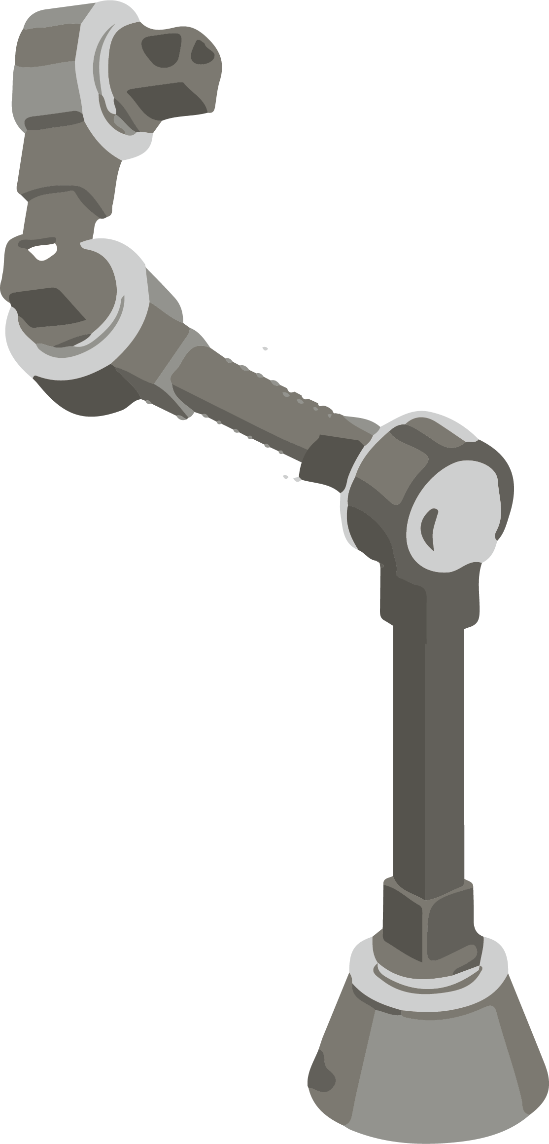

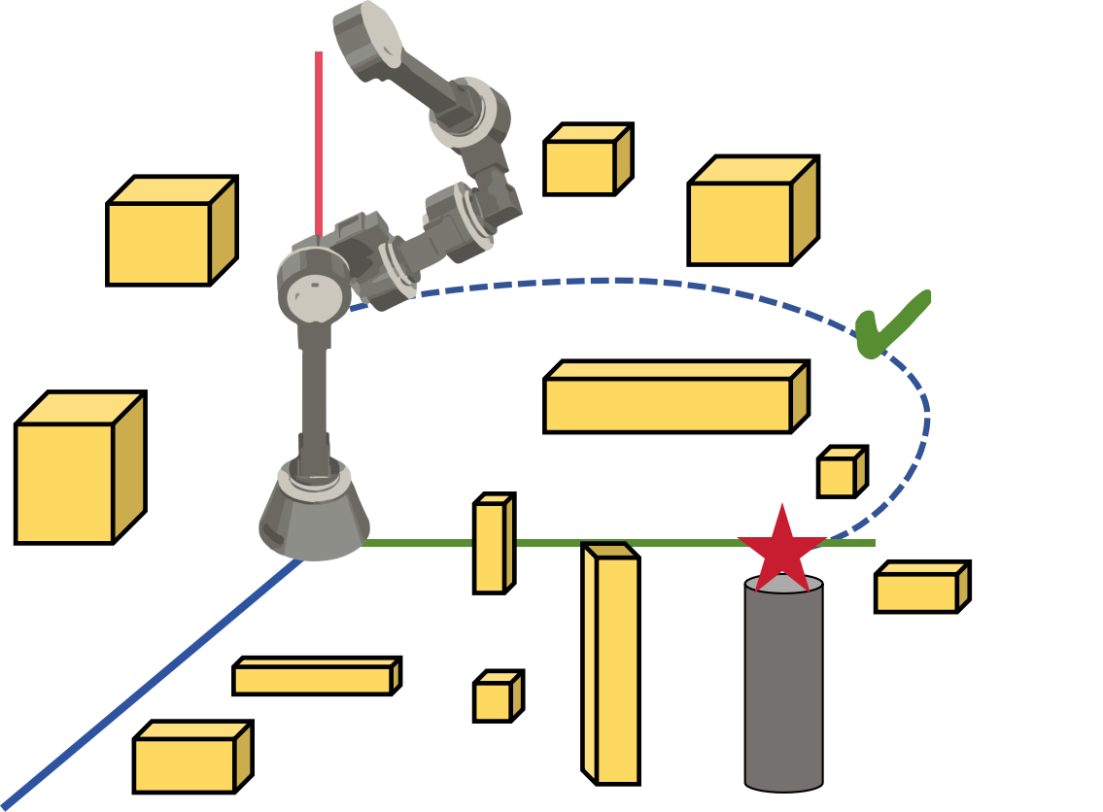
OptiBots
Convert to Modules
URDF
Unified Robot Description Format
A Pool of Modules
Algorithm Can Choose From
User: Lift the target object.
Optimizer: Genetic Algorithm
Fitness Function
Time
Cost
...
Reachability
Robot Control in Reality
Robot Control in Simulation

Slide 4
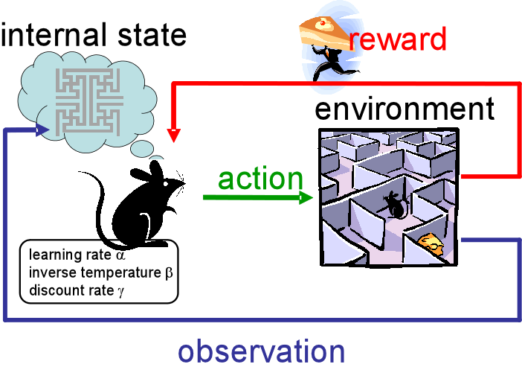

Slide 5
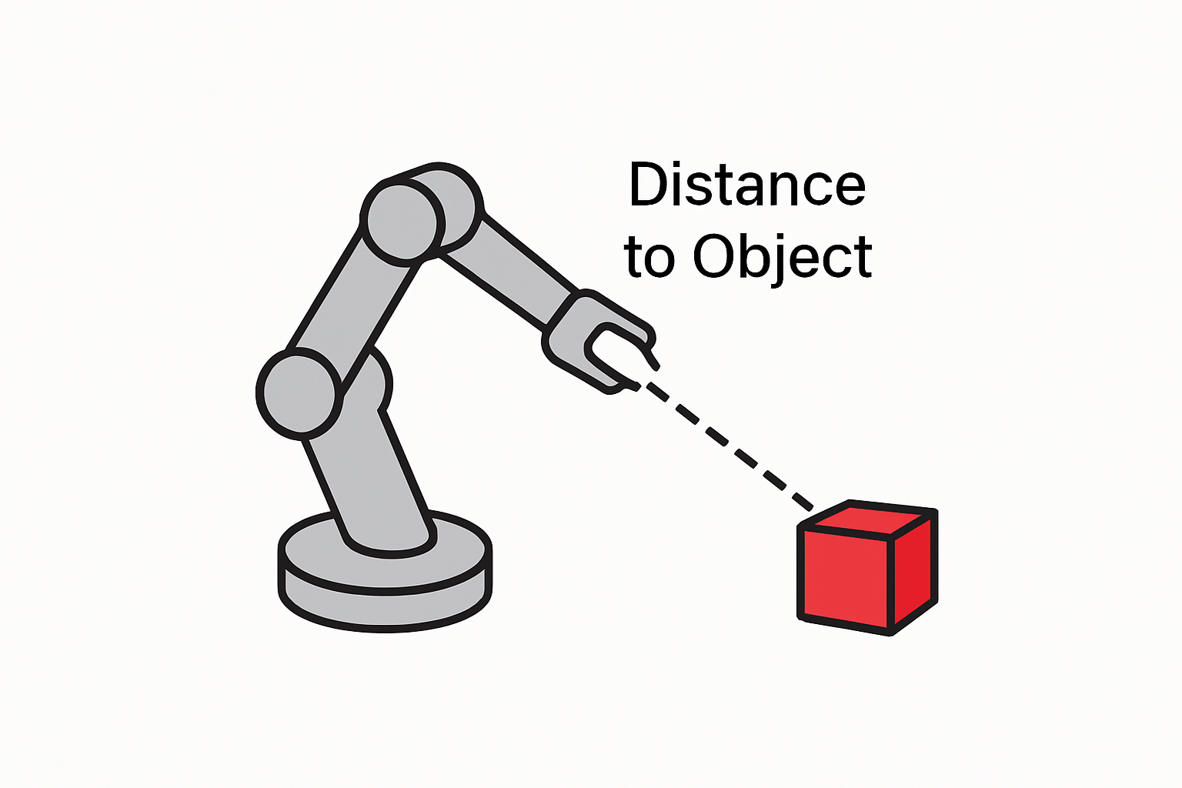

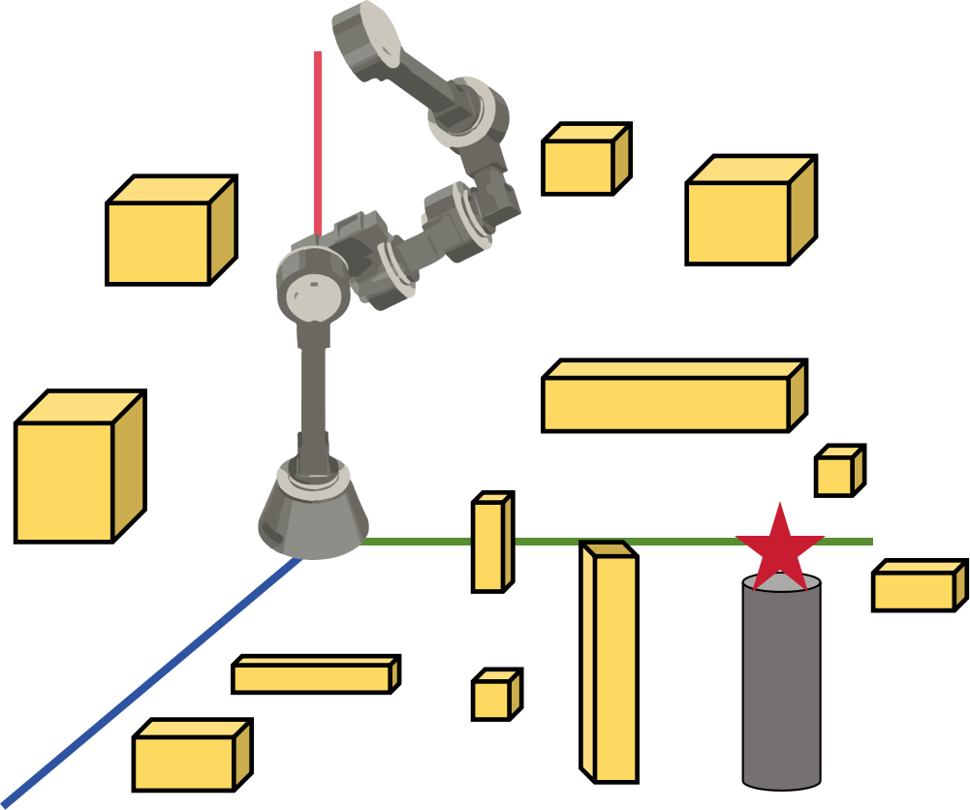
Pick Success
Rewards
Environment
Actions
Motor current / torque
Observation Joint positions; Object relative position

